Slide 1


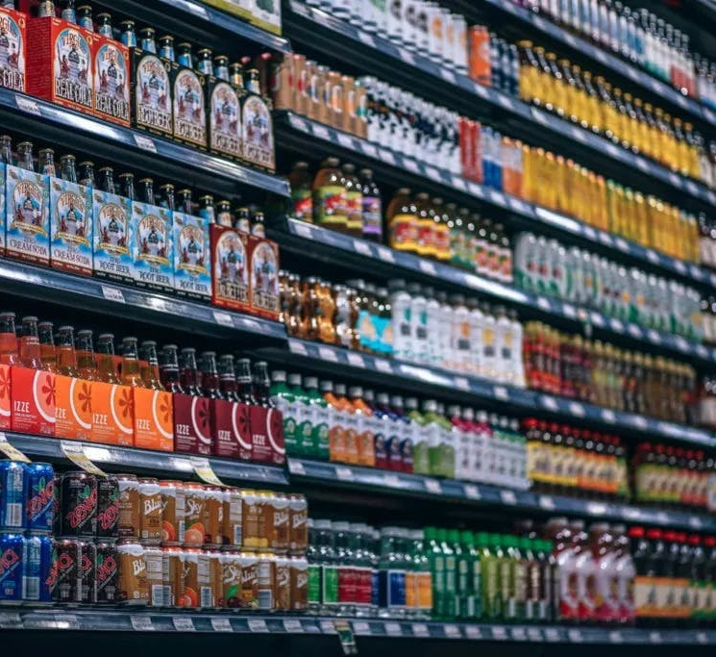
The Complete Journey
Team Members:
Prasad Kulkarni
Sathish Rajendiran
Kanning Wu

Slide 2

Executive summary (Plan)
Goal
Given our customer base of roughly 45,000 households, our goal is to segment and profile our customers based on factors such as income, shopping behavior, and demographics; then use this data to identify frequently paired items to develop a direct mail coupon campaign
Plan
We are planning to select specific segment or cluster of households which uses coupons slightly more often than the average customer. This provides the opportunity to persuade customers to purchase items they enjoy more frequently, and thus improve gross revenue.
We are planning to identify the most popular combination of items using association rule mining and analyzed the rules using the lift, confidence, support, and conviction metrics.
Based on a preset liability margin, we plan to determine the optimal coupon value that would encourage the consumer base to increase item sales frequency and overall revenue.
Tools
Excel/ XLSTAT, K-mean clustering, Association Rule Mining, Python

Slide 3
Research Objectives (Questions)
Who are potential coupon users?/ Major segments in the basket?
What's the relationship between price, quantity and coupon value?
Which are the most frequent items sold?
What's the optimal coupon value for selected most frequent items?/What is the Optimal segment for coupons redeemed?

Slide 4
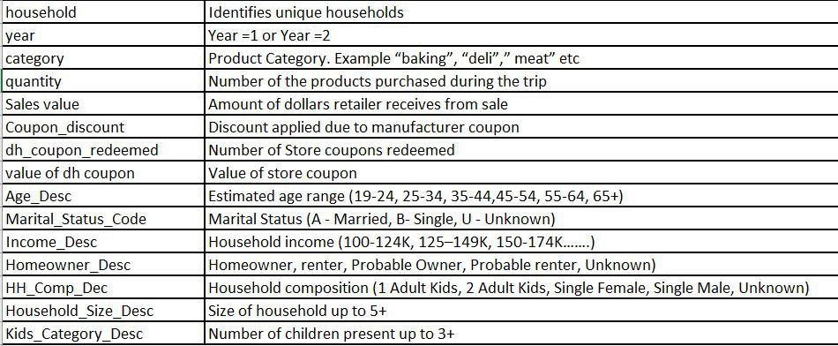
Dataset (Combination of multiple data files)

